Slide 1

React
Building and Styling UI

Slide 2
# Table of Contents
Thinking in React
Styling
Folder Structure
Mobile-First-Approach
Code Movie App

Slide 3
Review

Slide 4

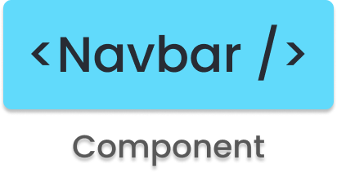
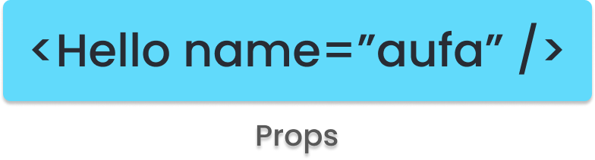
# Review

Slide 5
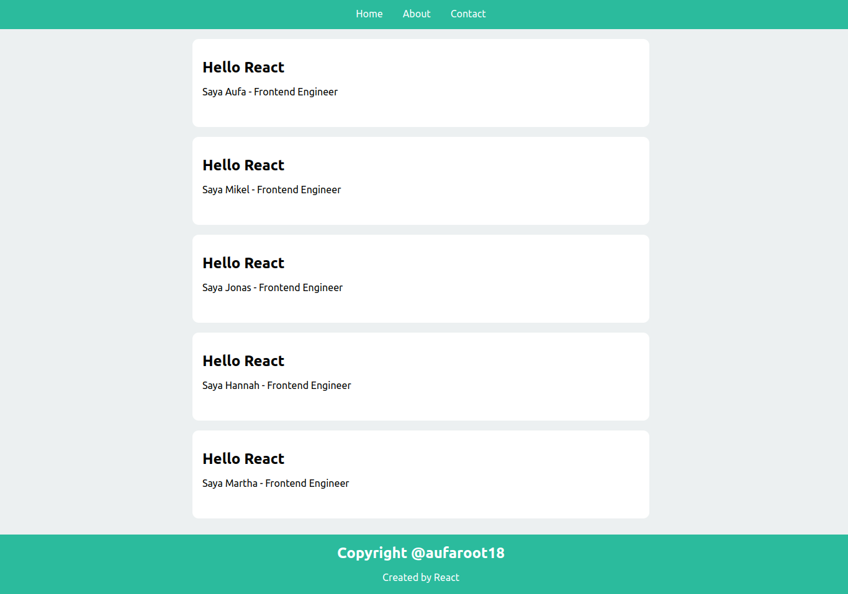
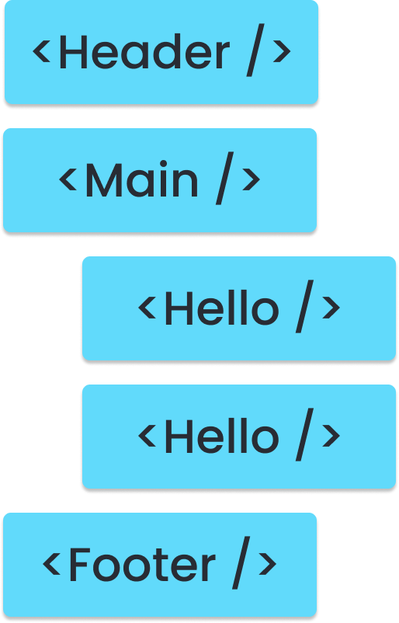

Slide 6
Thinking in React

Slide 7
# Thinking in React
Start with a Mock/Design
Break UI into Component
Build Static Version
Identify State
Referensi: React- Thinking in React.

Slide 8
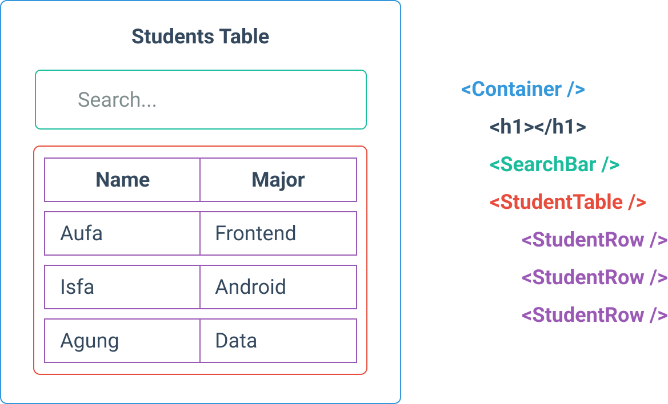

Slide 9
Styling

Slide 10
# Styling
Regular Stylesheet (CSS)
CSS Modules (CSS)
SASS (CSS Superpowers)
Styled Components (CSS-in-JS)
UI Framework (Component-base): Material UI, Ant Design, React Bootstrap,
Referensi: Nothing.

Slide 11
# CSS Modules
Class(es) are scoped locally (encapsulation)
CSS Modules is Regular CSS
File name: [name].module.css
Support: scoping css, avoid clash of class name, module.
Referensi: CRA - Add CSS Modules.

Slide 12
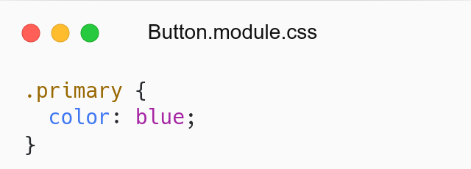
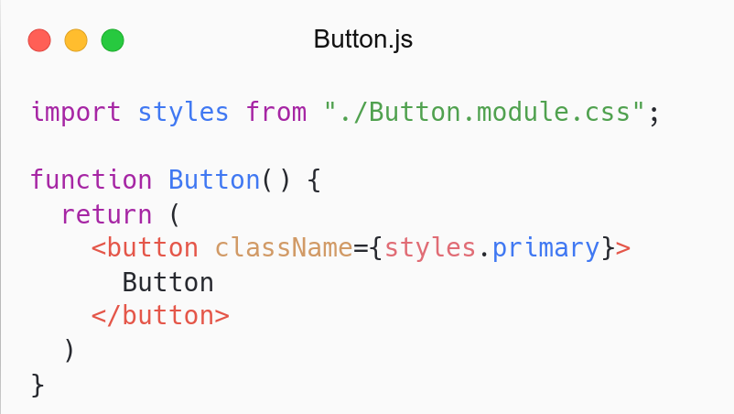
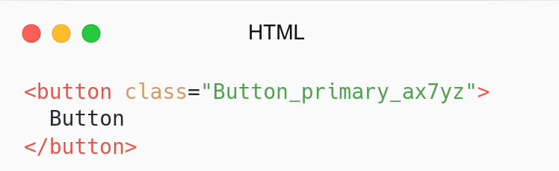
CSS Modules
Button Component
Result

Slide 13
Folder Structure

Slide 14
# Folder Structure
React doesn’t provide how to structure file & folder.
Common approaches:
Grouping by feature or route
Grouping by file type
Referensi: React - File Structure.

Slide 15
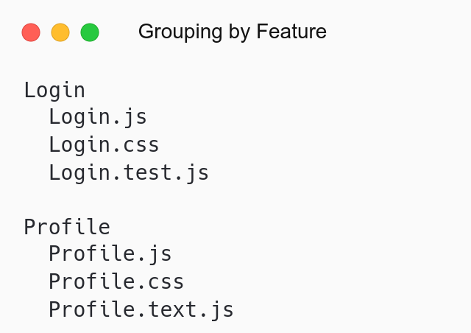
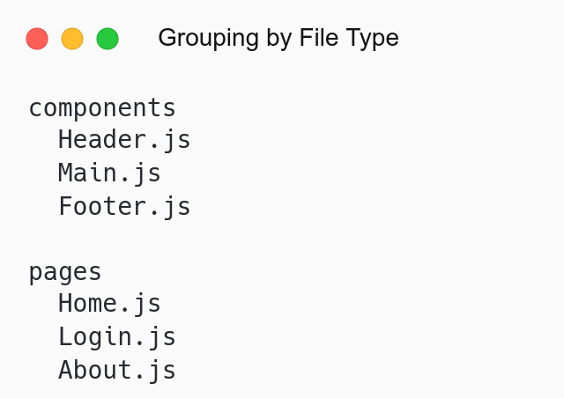

Slide 16
# Folder Structure
Folder | Description
components | Menyimpan berbagai components
pages | Menyimpan halaman-halaman
assets | Assets: gambar, svg, fonts, logo
utils | Utilities, constants, helpers
services | External resource
store | Global state: redux, context

Slide 17
Mobile-First

Slide 18
# Mobile-First
Responsive Web Design
Mobile-First-Approach
Using Media Query (CSS)
Referensi: Nothing.

Slide 19
# Breakpoint
Breakpoint | Dimension
small: phone | <758px (default)
medium: tablet | ≥768px
large: desktop, laptop, tv | ≥992px

Slide 20
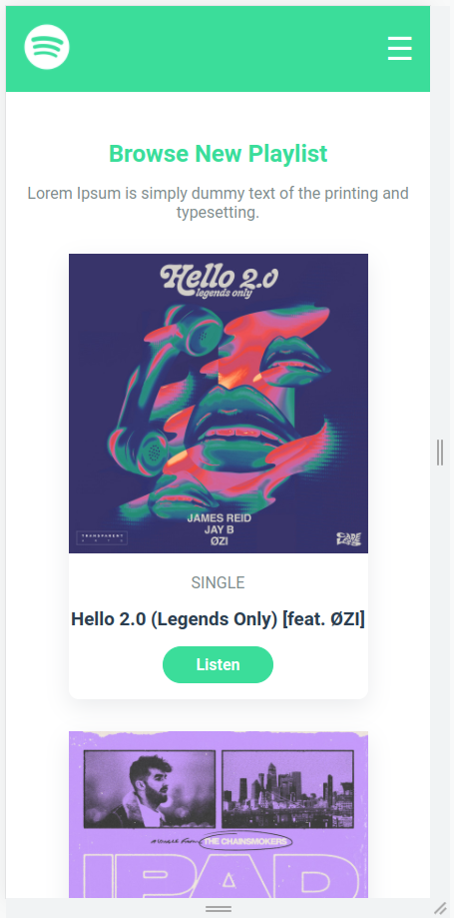
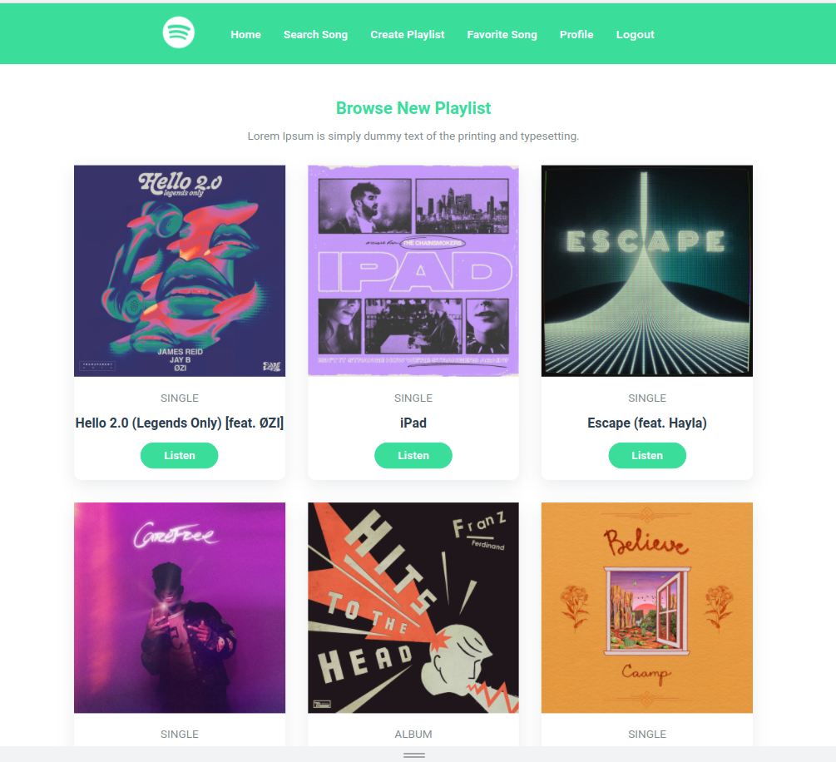
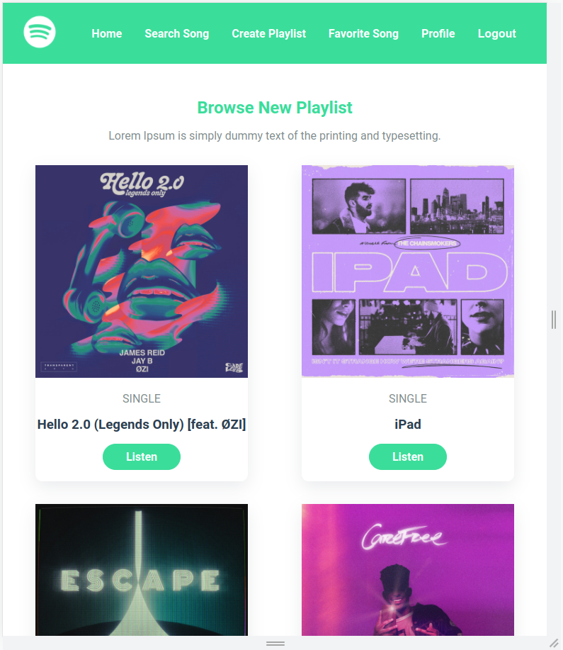
Small Device
Medium Device
Large Device

Slide 21
Setup

Slide 22
# Design
Register Figma: Link.
Duplicate Design: Link
Feel free to change according to your needs
Includes: Style Guide, Component, Pages
Referensi: Figma Design.

Slide 23
# Assets
Assets | Source
Image | Picsum Photos
Fonts | Google Font
Color Palette | Coolors
CSS | Github

Slide 24
# Reset CRA
Remove styling in index.css file.
Add CSS Reset in index.css.
Delete App.css file.
Remove all components in App.js Component.
Referensi: CRA - Adding CSS Reset.

Slide 25
Movie App

Slide 26
# Home Page
Membuat halaman Home.
Simpan di folder src/pages/.
Page: Home.js.

Slide 27
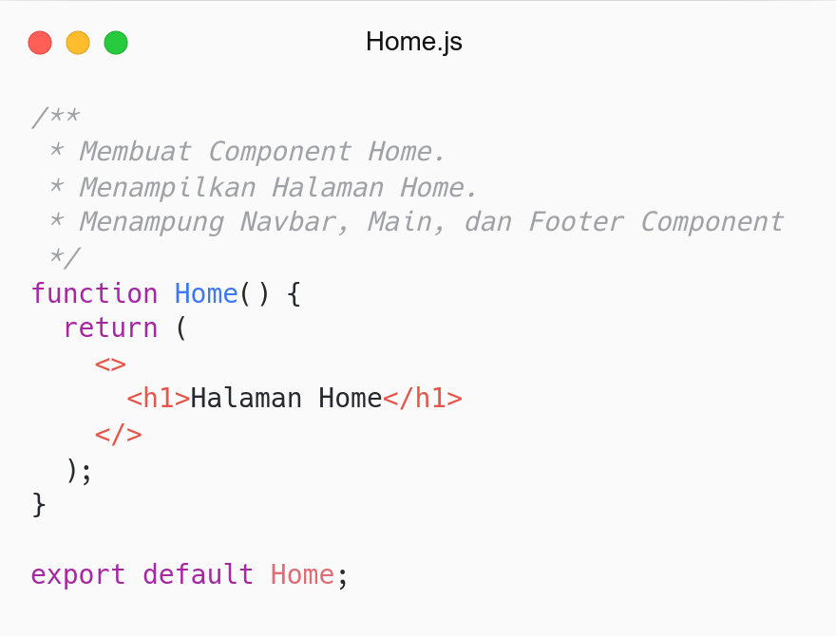
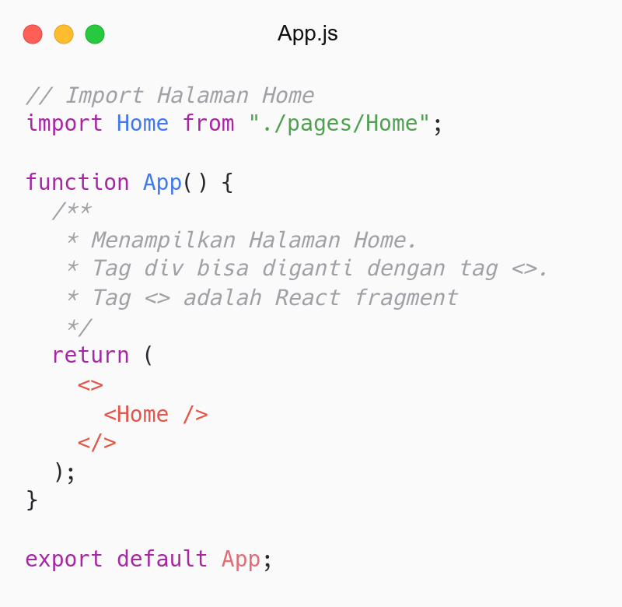

Slide 28
# Navbar Component
Membuat navigasi.
Simpan di folder src/components/Navbar/.
Component: Navbar.js.
CSS: Navbar.module.css.

Slide 29
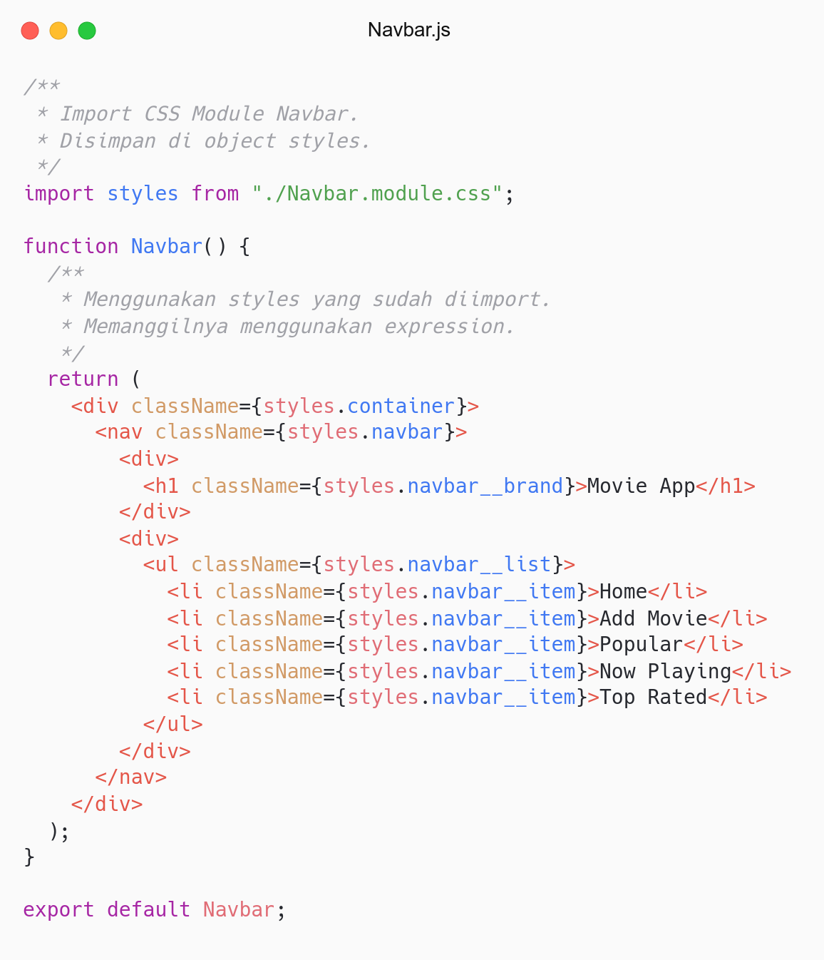
Navbar Component

Slide 30
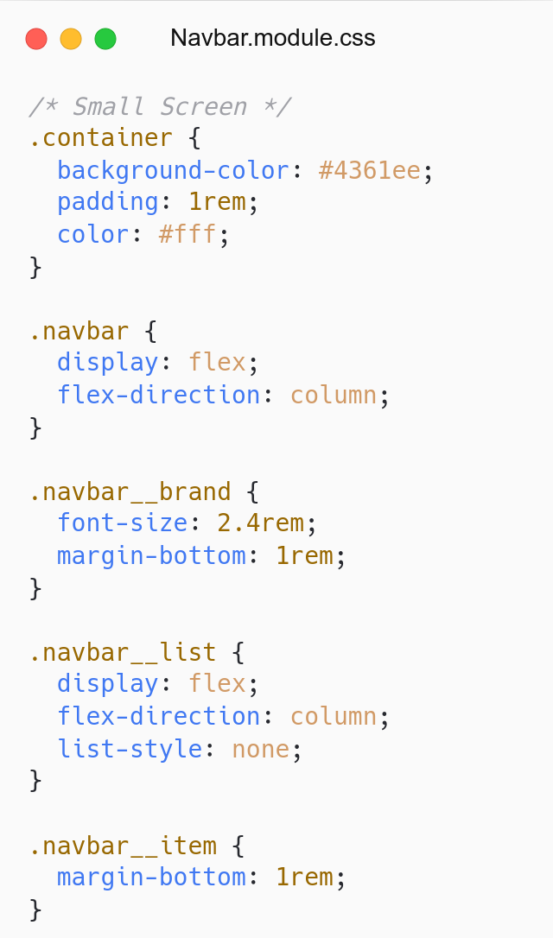
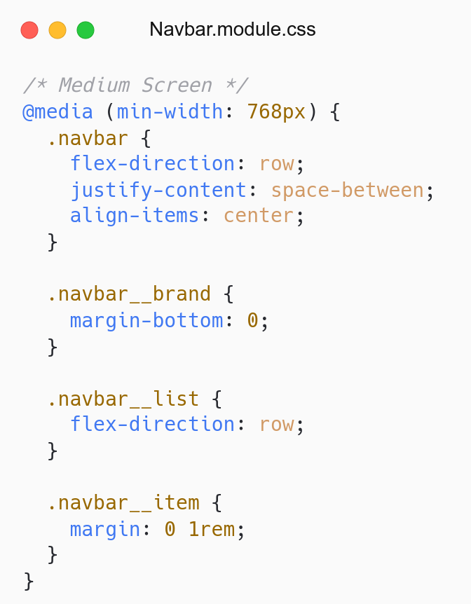
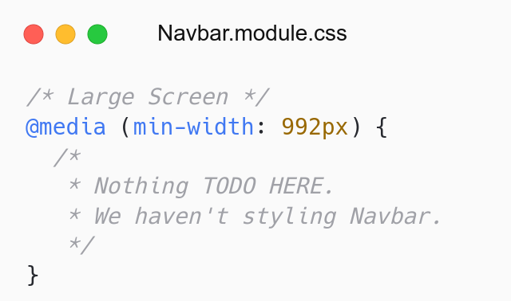
Small Screen
Medium Screen
Large Screen

Slide 31
# Footer Component
Membuat footer website
Simpan di folder src/components/Footer/.
Component: Footer.js.
CSS: Footer.module.css.

Slide 32
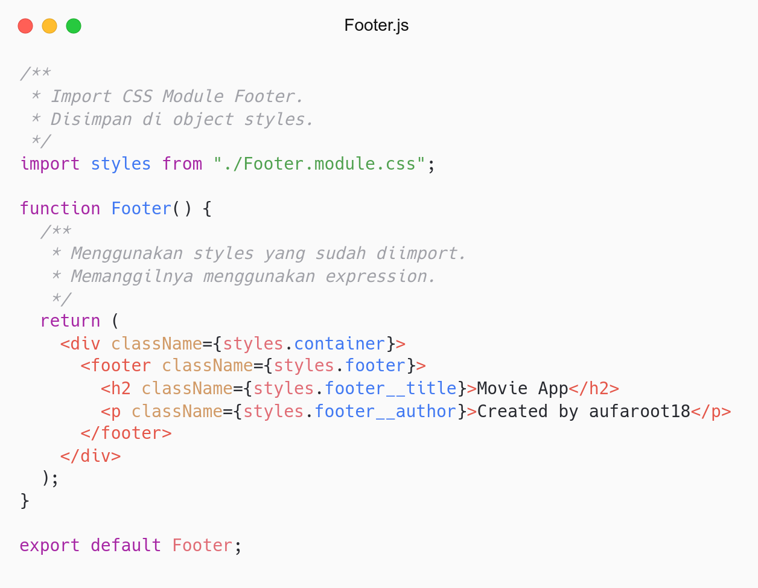
Footer Component

Slide 33
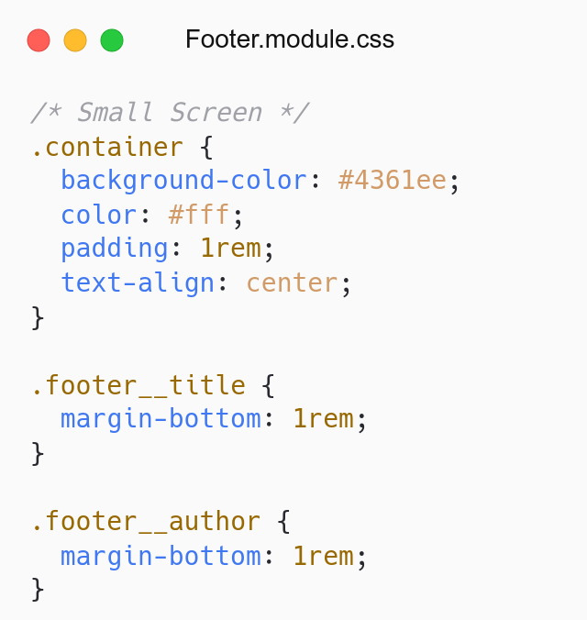
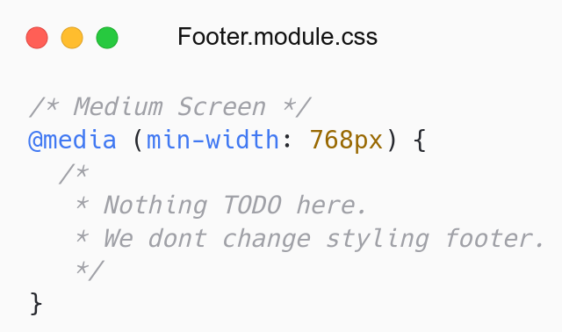
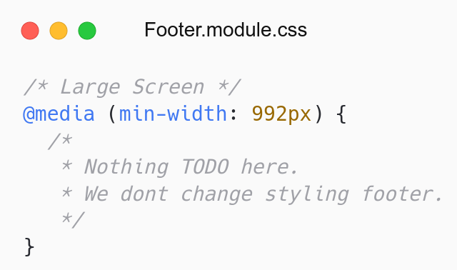
Small Screen
Medium Screen
Large Screen

Slide 34
# Hero Component
Membuat hero/header/banner/jumbotron website
Simpan di folder src/components/Hero/.
Component: Hero.js.
CSS: Hero.module.css.

Slide 35
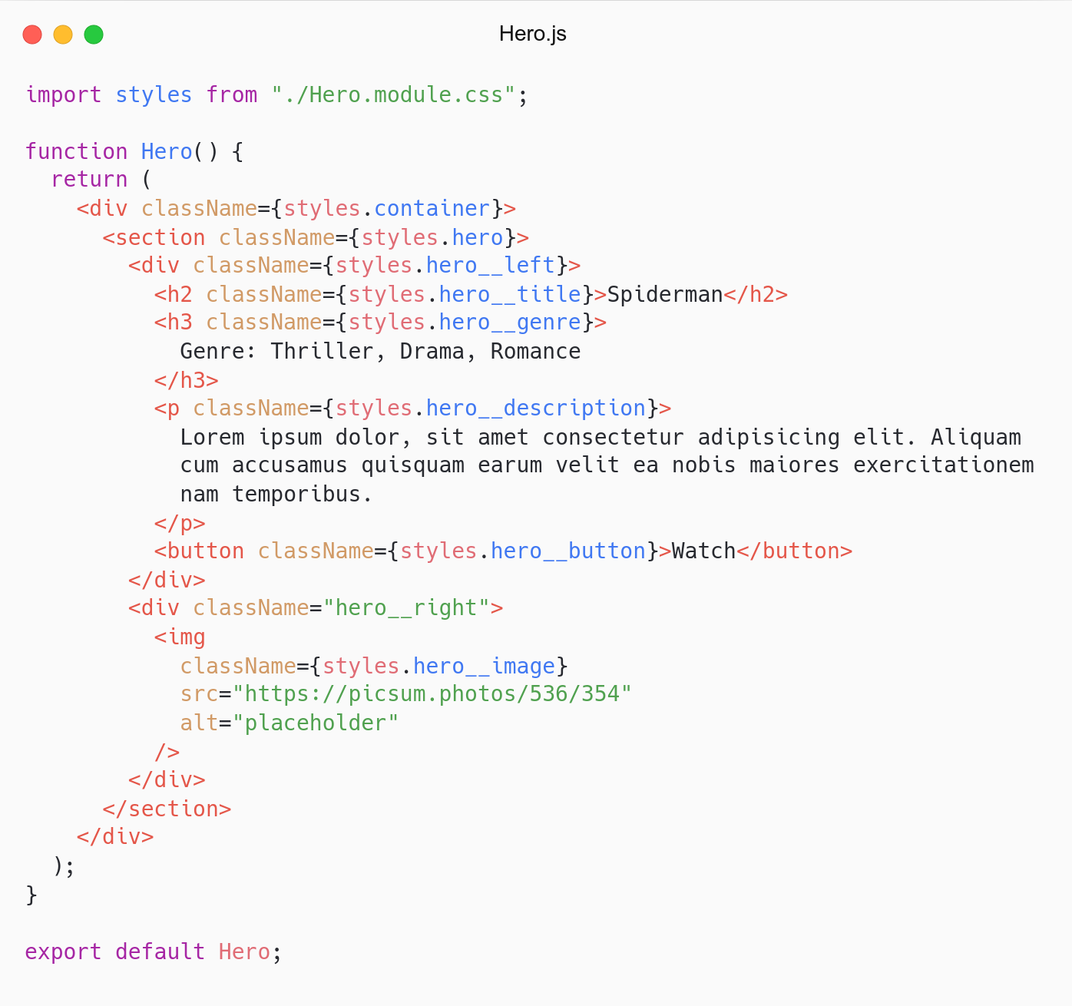
Hero Component

Slide 36
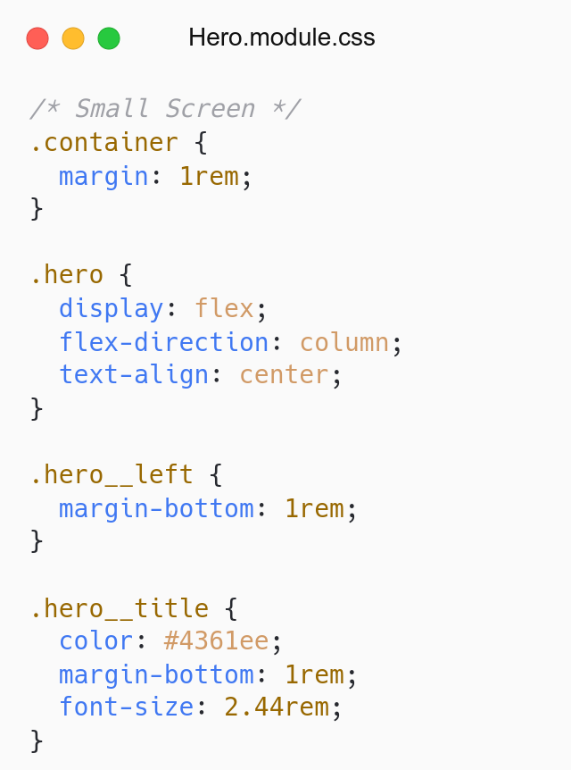
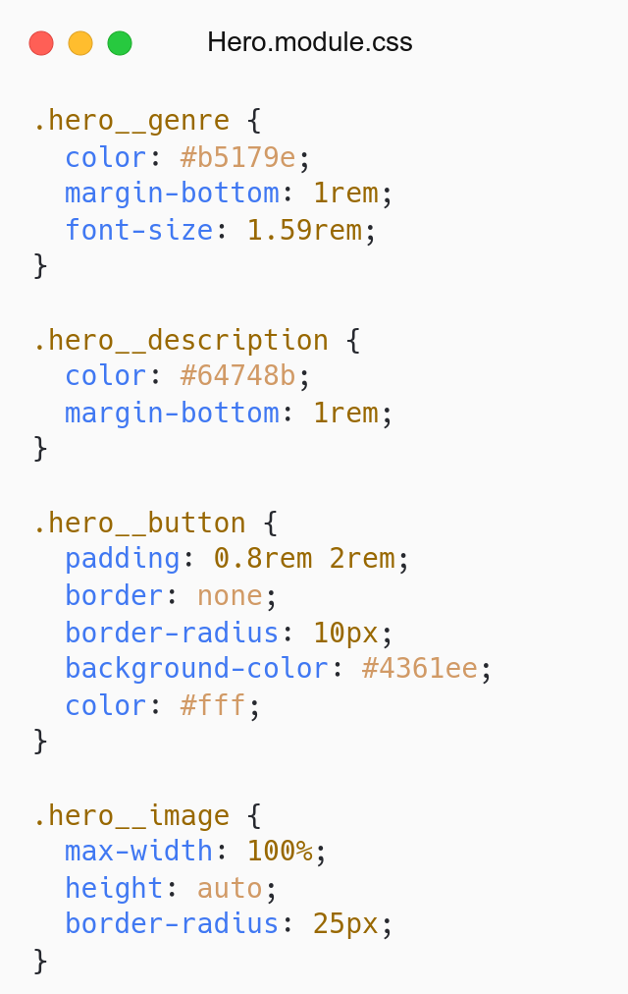
Small Screen

Slide 37
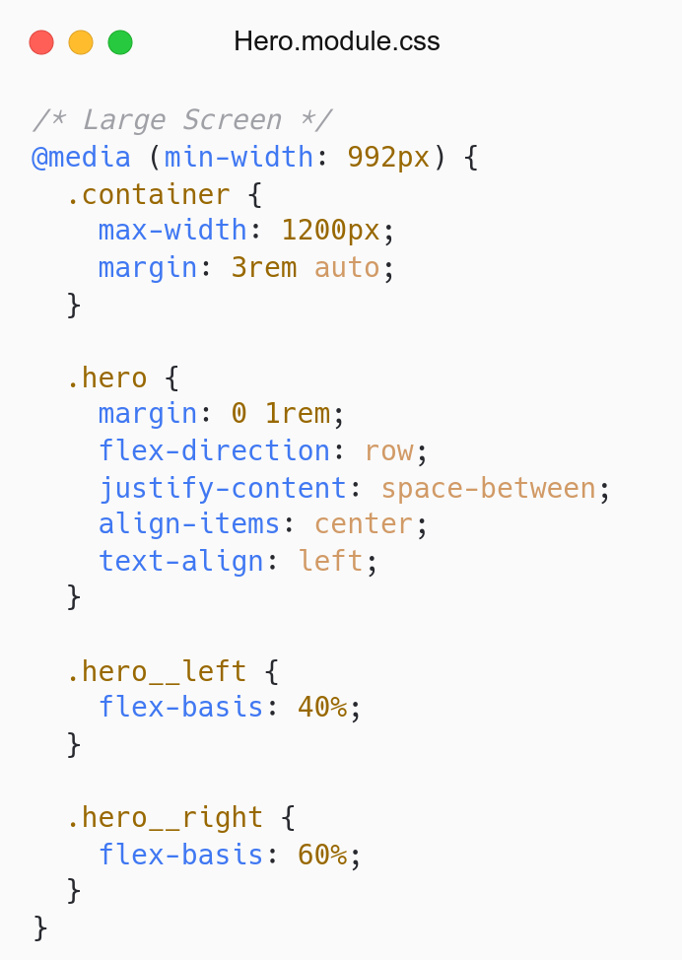
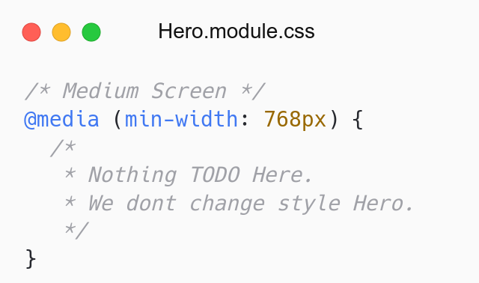
Medium Screen
Large Screen

Slide 38
# Movies Component
Menampilkan daftar movies
Simpan di folder src/components/Movies/.
Component: Movies.js.
CSS: Movies.module.css.

Slide 39
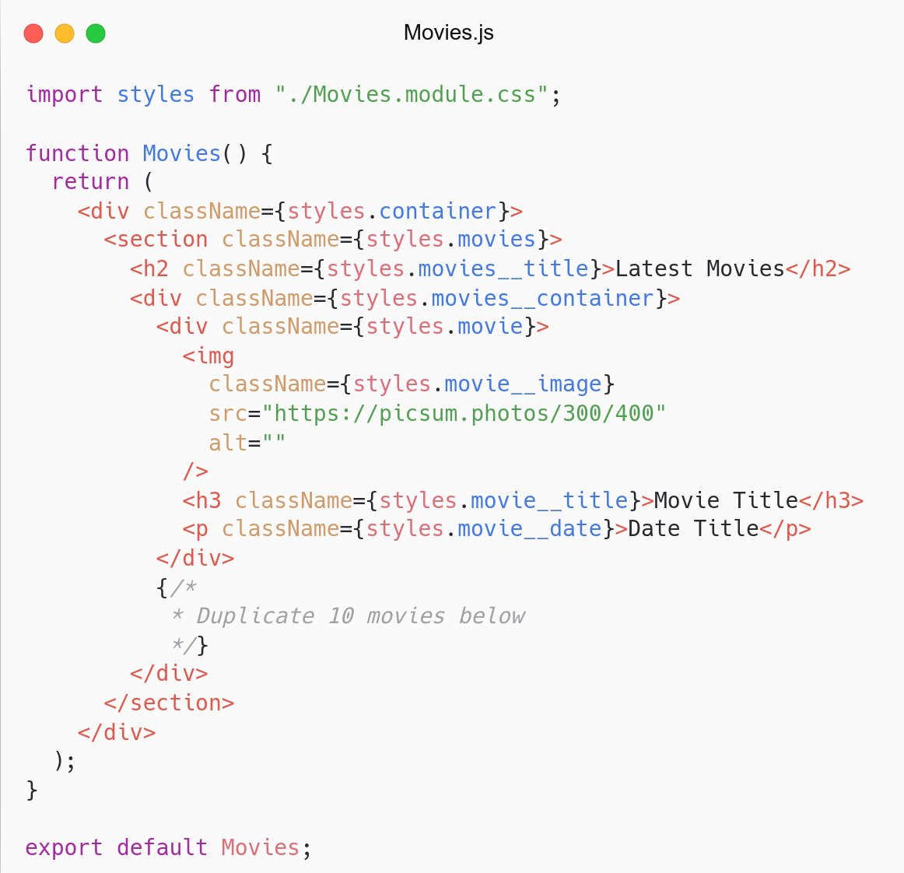
Movies Component

Slide 40
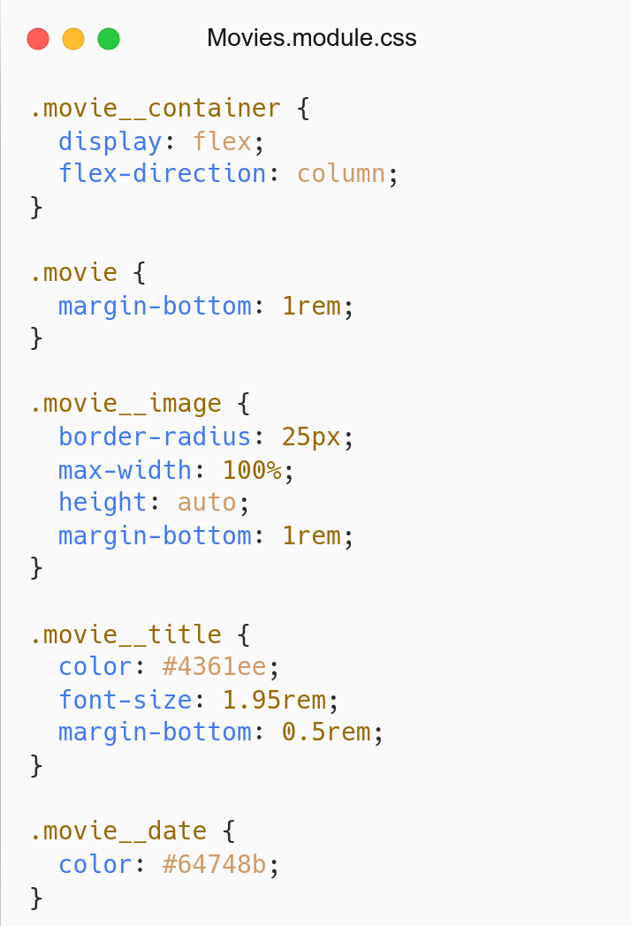
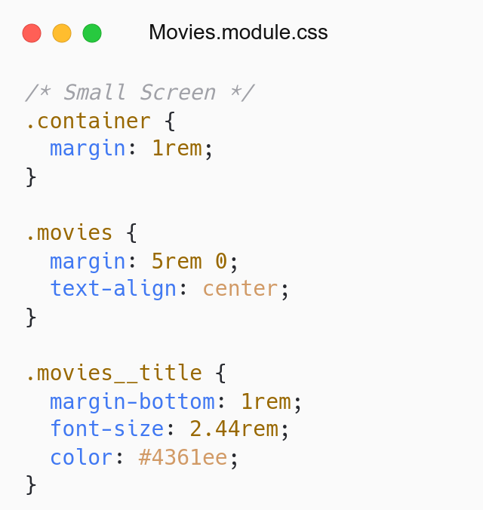
Small Screen

Slide 41
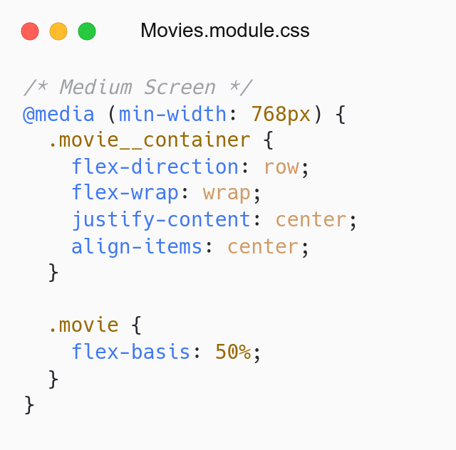
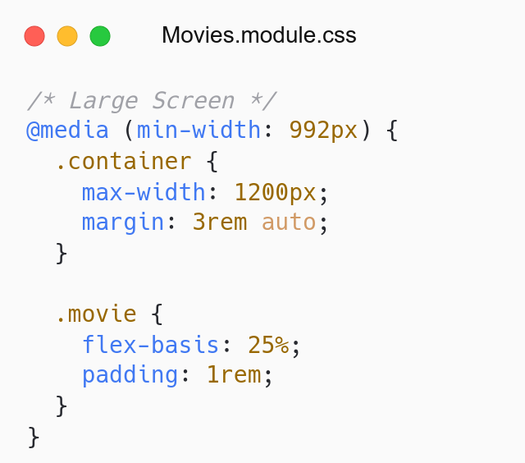
Medium Screen
Large Screen

Slide 42
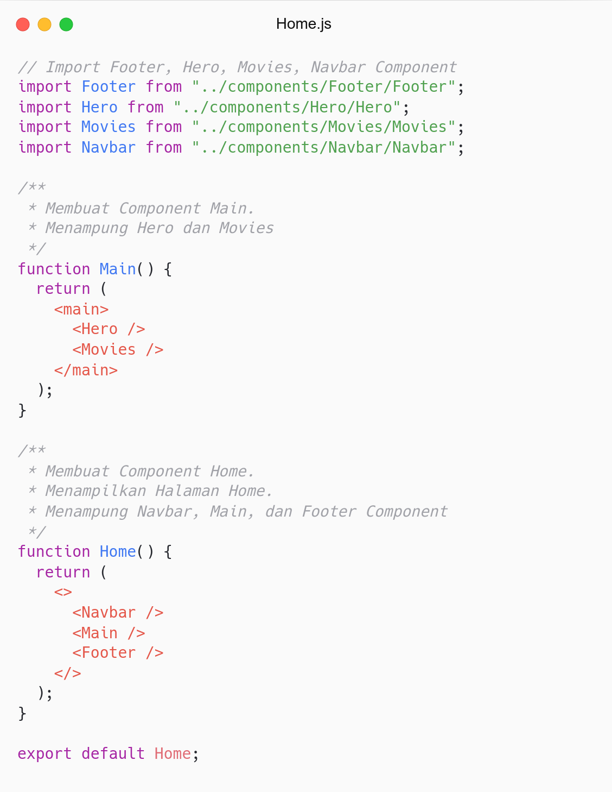

Slide 43
QnA

Slide 44
Take Away

Slide 45
# Task
Description:
Task boilerplate: Link.
Practice Component and CSS Module.
Assignment:
Push code to Repository Github (use branch for task management).
Task tidak perlu dizip dan folder node_nodules tidak perlu diupload.
Submit link repository to elena.
Kamis: 24 Maret 2022, Link Elena.
Jumat: 26 Maret 2022, Link Elena.

Slide 46
# TODO
Membuat Component untuk Menambahkan Movie (Form).
Simpan di folder src/components/AddMovieForm/.
Component: AddMovieForm.js
CSS: AddMovieForm.module.css
Design Component sesuai Figma atau Custom.
Tampilkan Component di halaman Home (sesuai design).
Hint:
HTML Form: Devsaurus - Form
CSS Flexbox: Devsaurus - Flexbox.

Slide 47
Attendance

Slide 48
Thanks

